Slide 1

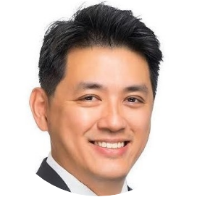
AI-augmented quant trading strategies
Algorithmic Trading &
Options Risk Management
9 April 2026
Speaker
Kelvin Foo

Slide 2
About The Speaker
Dr Kelvin Foo
Founder and Managing Partner, Elemen79 | EPAT Alumnus
Dr Kelvin Foo is the Founder and Managing Partner at Elemen79. He has experience in asset management, private banking, insurance and technology. His expertise lies in quant methods, risk management and AI applications in financial markets. Kelvin holds a PhD in Finance from EDHEC, an MBA in International Business & Finance from Imperial College, an MSc in Risk and Asset Management from EDHEC, and a BSc in Physics from the National University of Singapore. He has completed EPAT, CAIA and many other professional certifications.

Slide 3

Investment Approach
Elemen79 democratizes sophisticated investment strategies through AI-augmented insights and quantitative methods
It transforms complex market data into actionable intelligence, making institutional-grade investment capabilities accessible to all investors
Built with a strong focus on risk management, it combines artificial intelligence with proven quantitative approaches to deliver consistent, risk-adjusted returns while protecting capital across all market conditions
Investment Capabilities Powered by AI
Advanced artificial intelligence algorithms analyze vast amounts of market data to identify patterns, trends, and opportunities that human analysis might miss.
Machine learning-driven strategy optimization
Real-time market sentiment
analysis
Automated portfolio rebalancing
Predictive risk modeling
Risk Awareness
Comprehensive risk management is at the core of every investment decision, ensuring capital preservation while pursuing optimal returns
Dynamic drawdown controls and monitoring
Multi-dimensional risk
assessment
Real-time portfolio stress testing
Volatility-based position sizing

Slide 4
Founder Experience & Qualifications
+
AI Augmentation
Investments
Dev
Backtest
Analytics
30
70
Guidelines
Stress test
Monitoring
Risk
Product Dev & Mgt
40
Optimization
Deployment
Execution
60
Quantitative Development
Front end
Back end
Full Stack
Project Mgt
100
90
DevOps
DBA
Architecture
10
Technology
QA
UI/UX
Security

Slide 5
Common ‘Investment’ Issues
Noise
Diverse info sources of varying quality & timeliness, advice from “Experts”
Monitoring
Constant eyeballing charts, listening to news, deciding on what to make of policy changes
Skill vs Luck
70–90% of retail investors lose money
For the 1 trade that retail investors make money, brag to friends about their 90% win

Slide 6
Elemen79 Investment Philosophy
Portfolio Construction
Signal Diversification through various portfolio construction techniques to achieve optimal risk-adjusted returns
Alpha
Signal generation using quantitative methods, and allocation to prevailing investment themes on a risk-aware basis
Selection
Selection of the most liquid and widely held ETFs
Reduced search costs & inherent diversification through diverse holdings in ETFs

Slide 7
Investment Process
Backtest
Analytics
Portfolio Construction

Slide 8
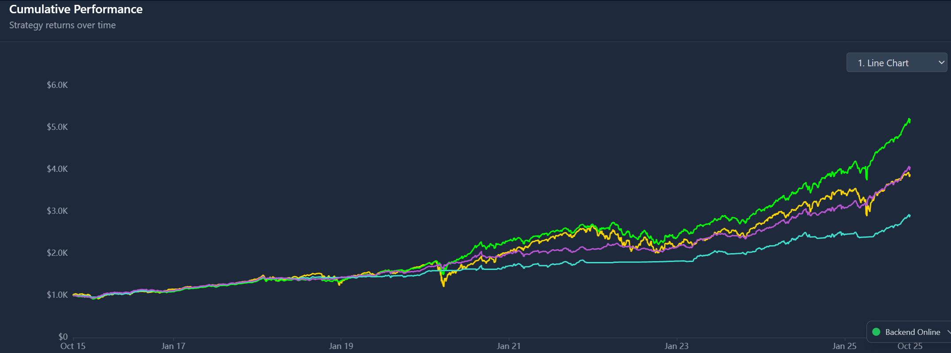
Backtest

Slide 9
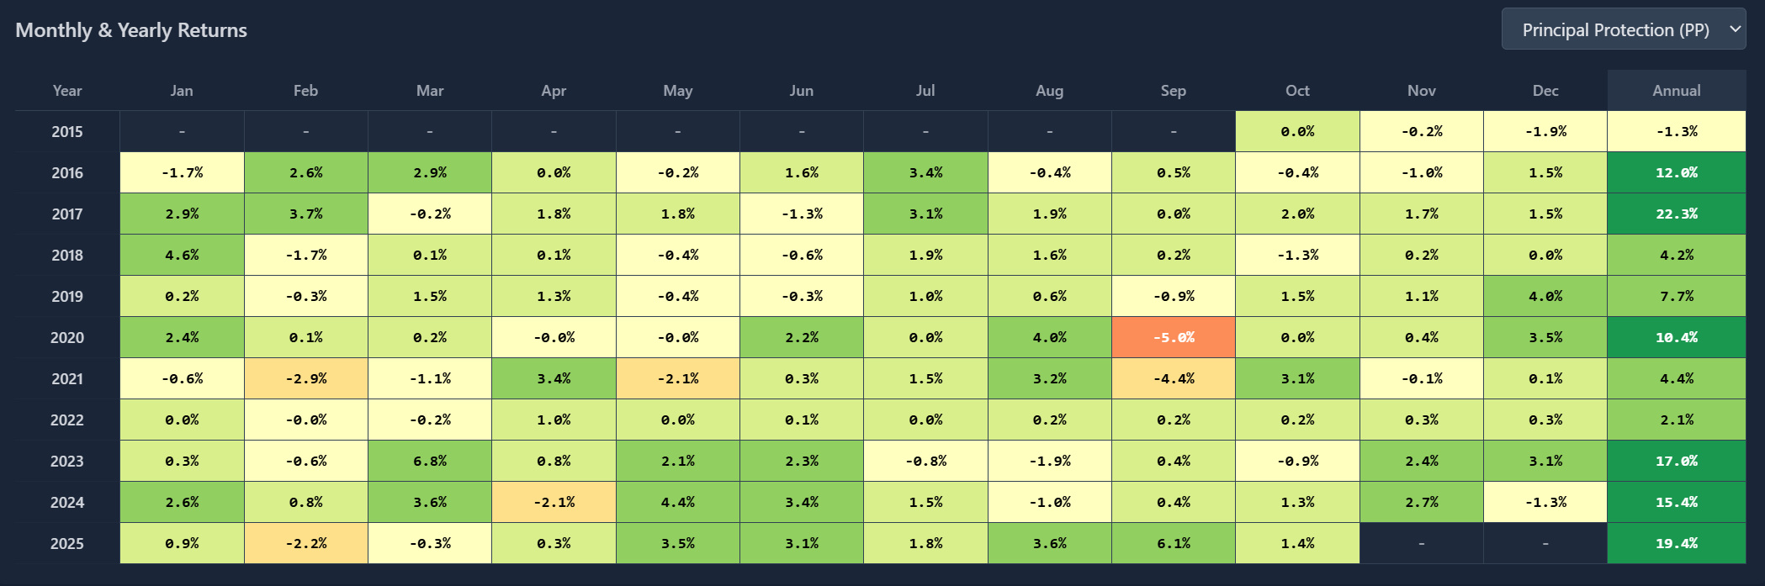
Backtest

Slide 10
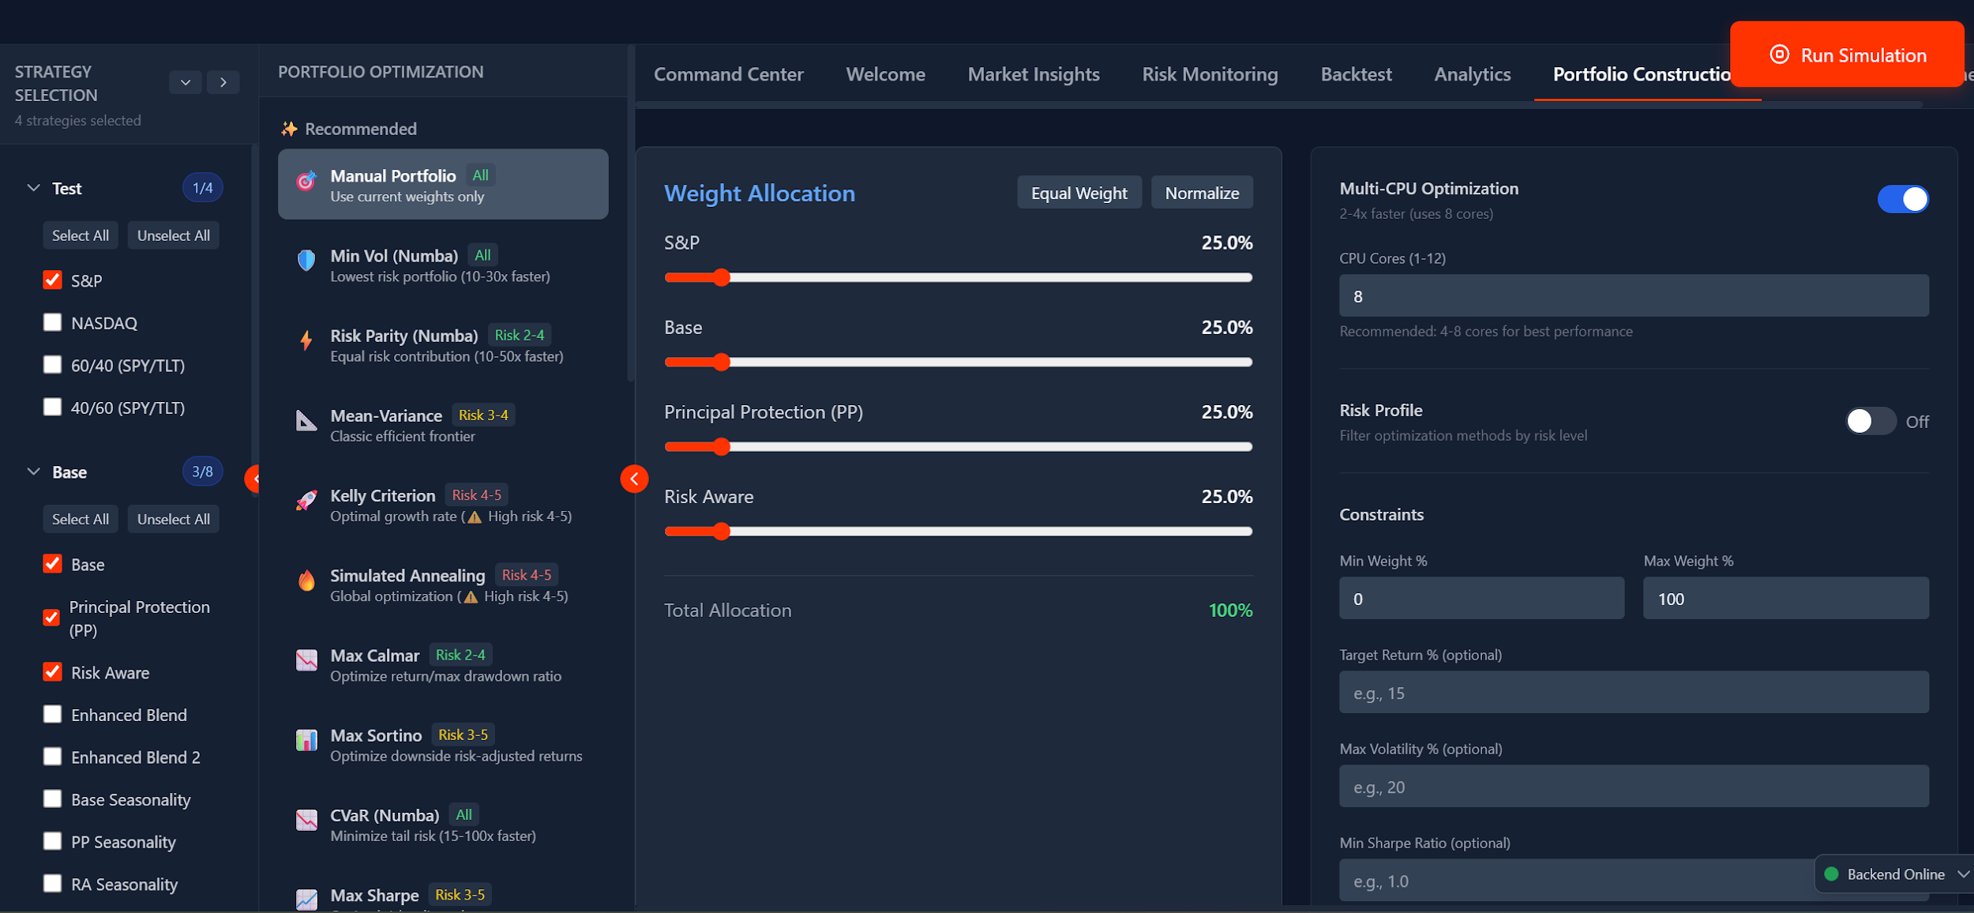
Portfolio Construction

Slide 11
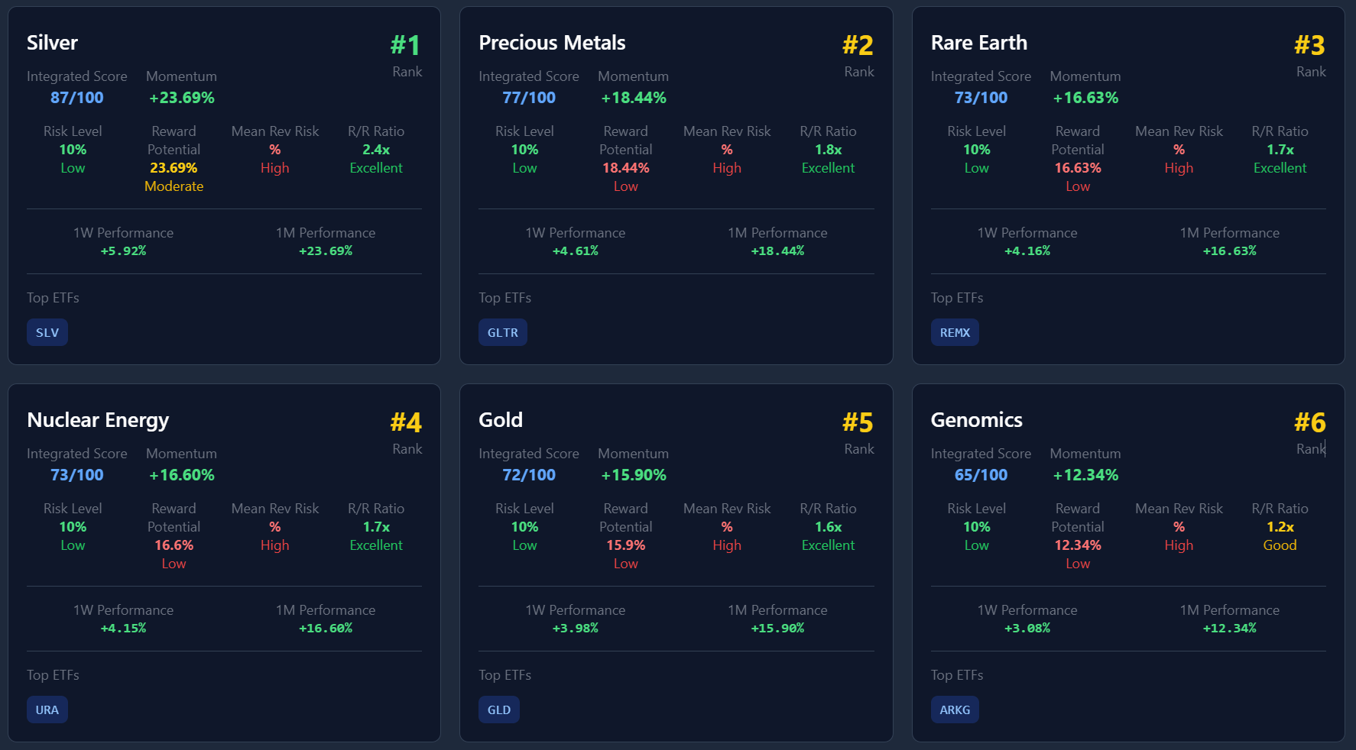
Monitoring Investment Themes Tracker

Slide 12
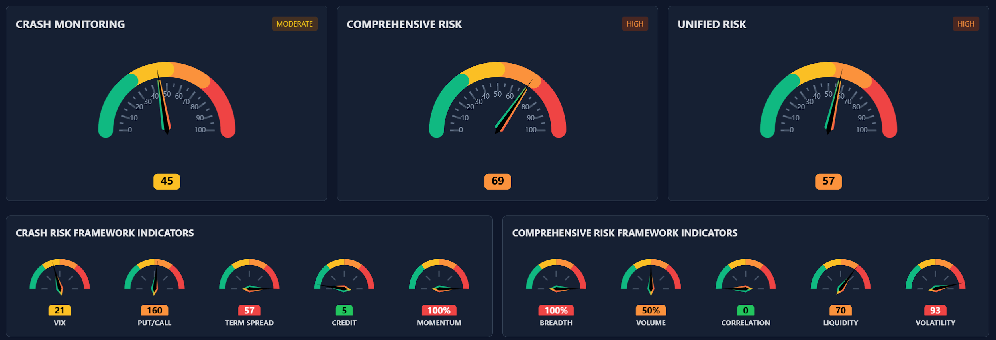
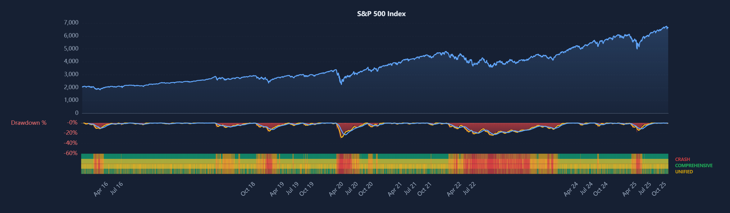
Monitoring Risk

Slide 13
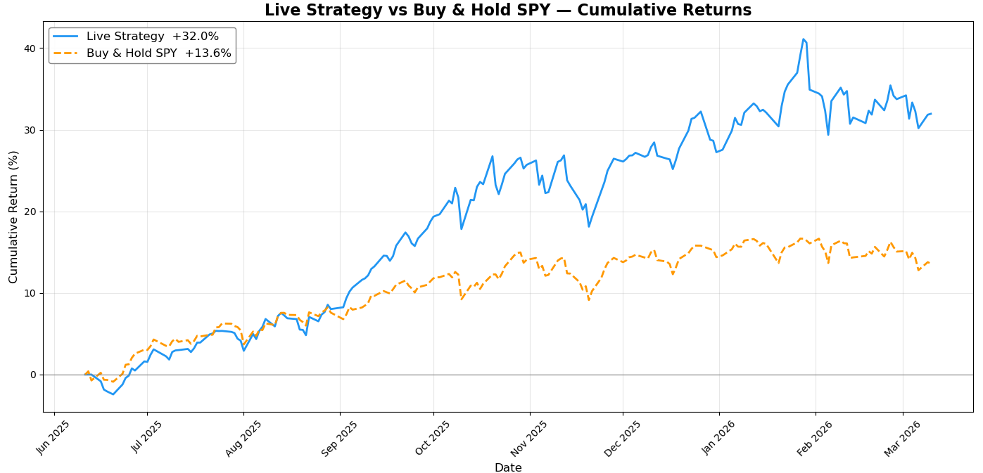
Live Performance (Phase 1 Legacy Strategy 9 Months)

Slide 14
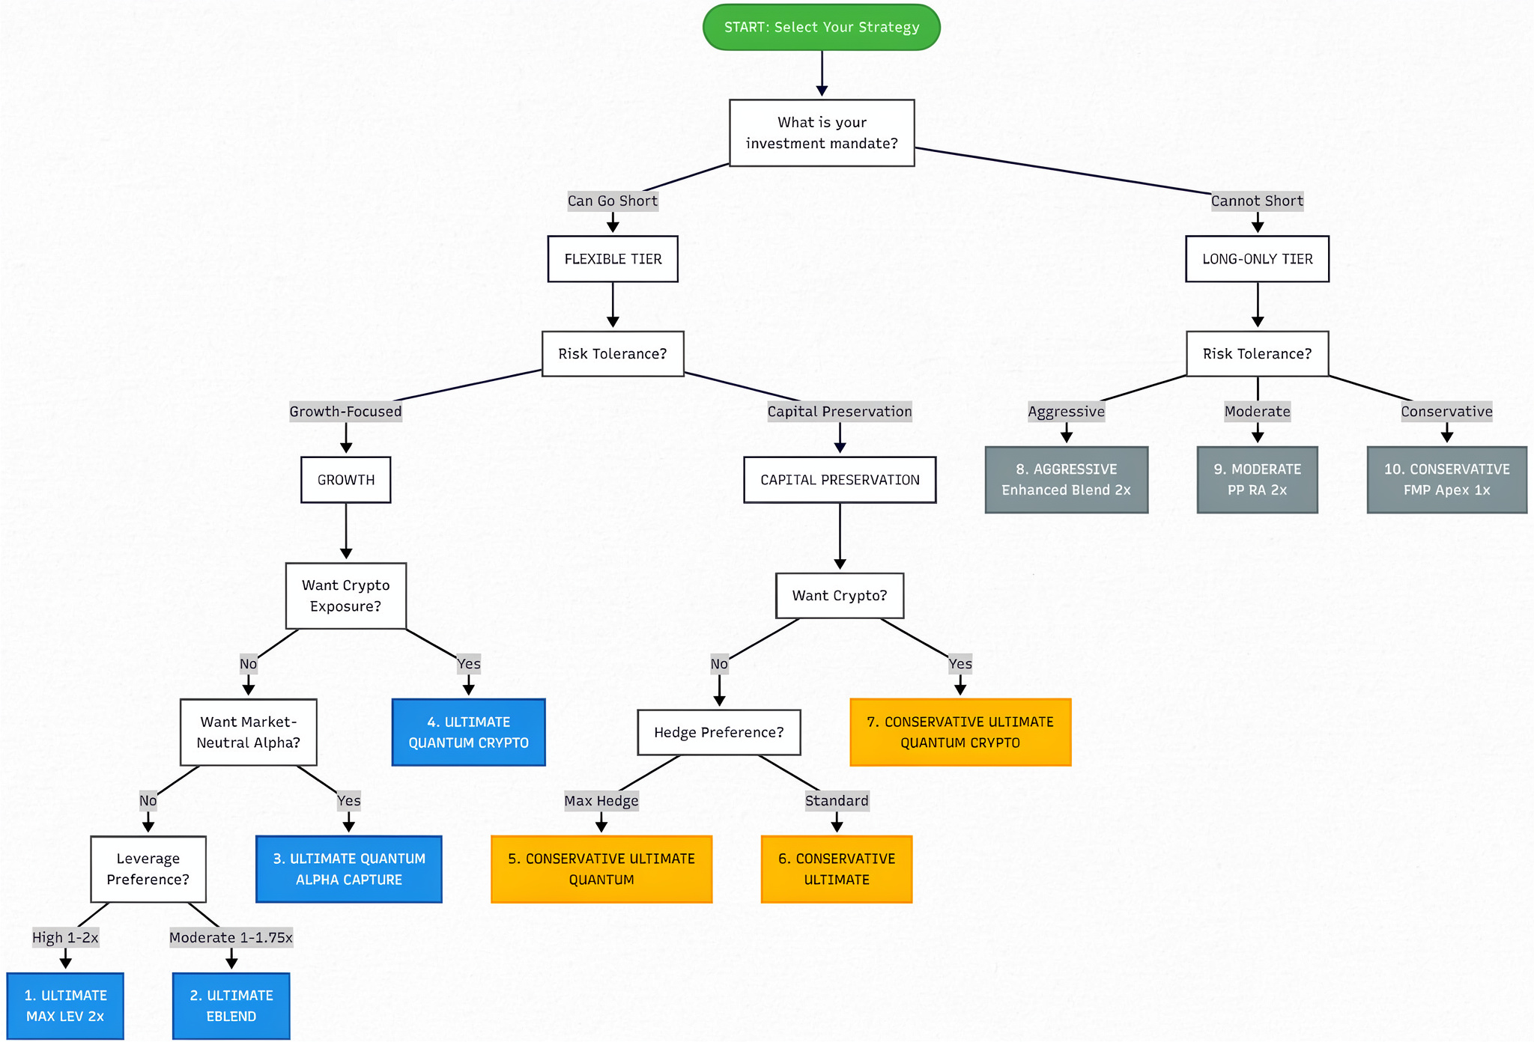
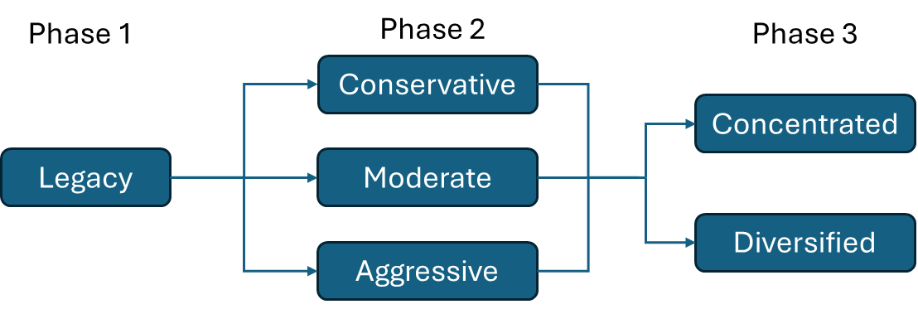
Phased Upgrades
Phase 2
Phase 4
Integration
Upgrades based on further insights and live testing
Improvements in risk-adjusted returns, especially Sortnio and Expectancy

Slide 15
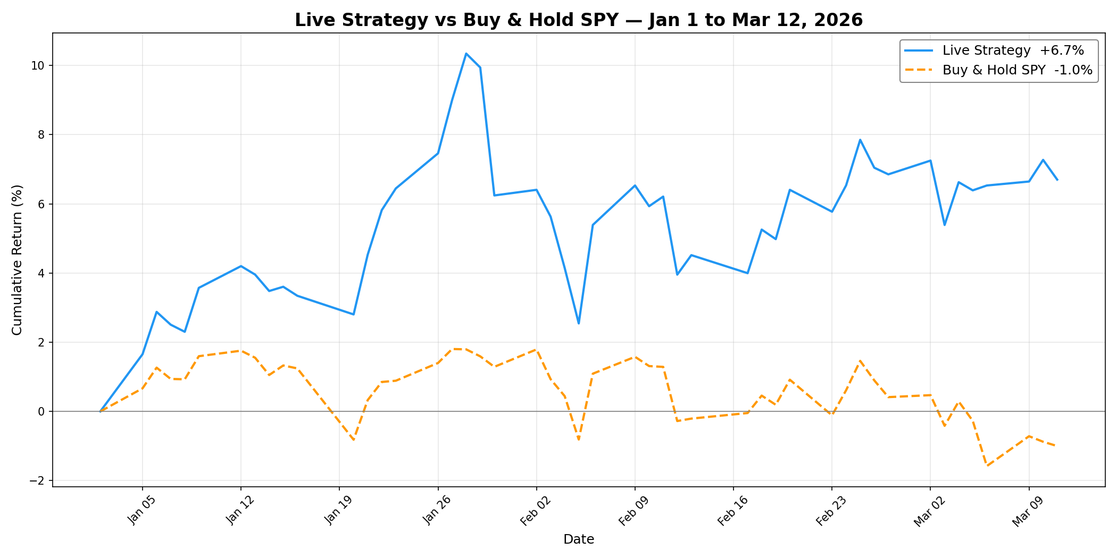
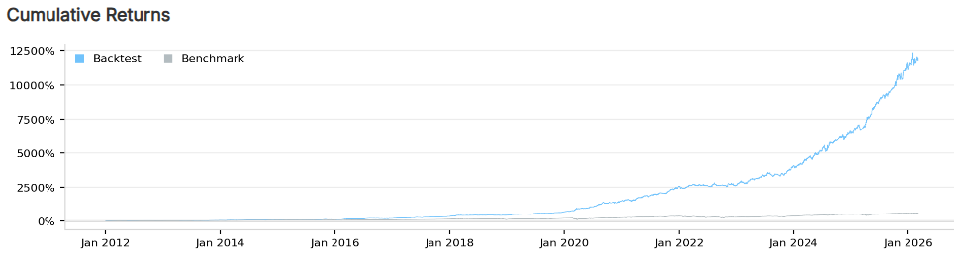
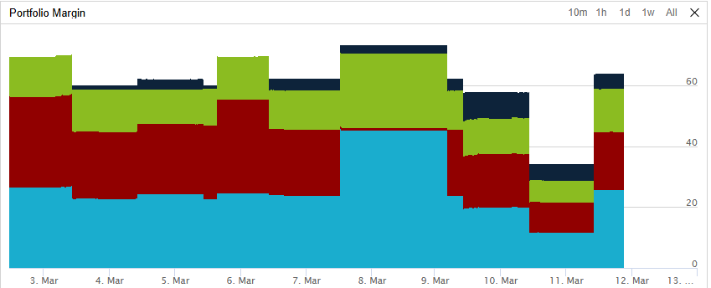
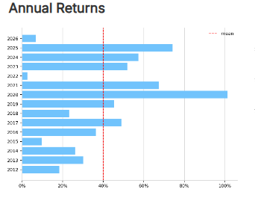
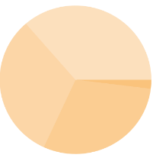
Phase 3 (Diversified)
Live
Backtest
Event-based backtest (Jan 2012 - Jan 2026)
CAGR | 40% | Max DD | 14.9%
Sharpe | 2 | Sortino | 2.5
Turnover | 7% | Expectancy | 0.9
Win rate | 75% | Profit-Loss ratio | 1.5

Slide 16
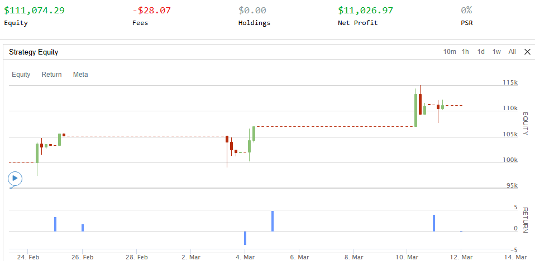
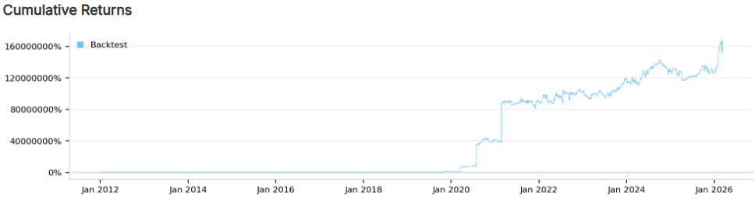
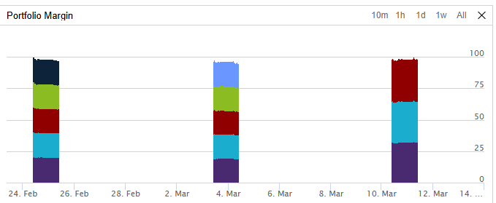
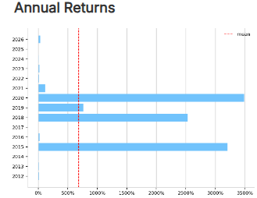


Phase 3 (Concentrated)
Live
Backtest
Event-based backtest (Jan 2012 - Jan 2026)
CAGR | >40% | Max DD | 18.6
Sharpe | 1.9 | Sortino | >3
Turnover | 51% | Expectancy | >1
Win rate | 52% | Profit-Loss ratio | >2

Slide 17
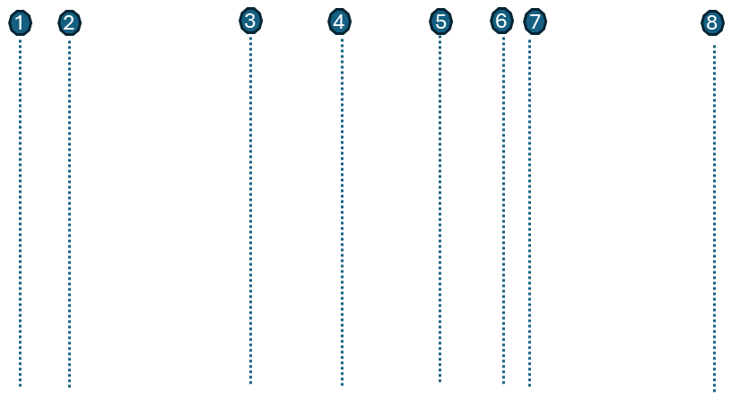
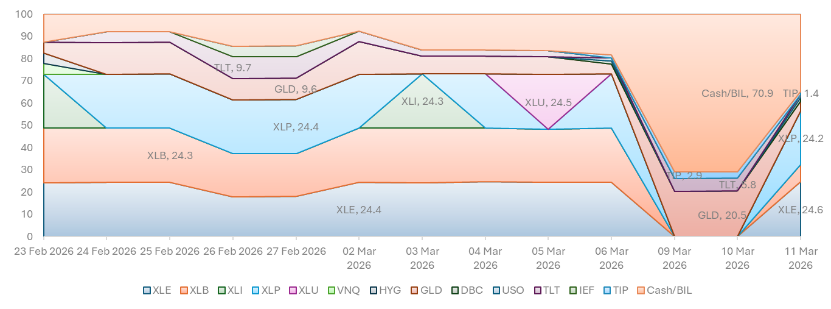
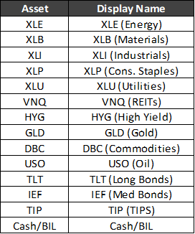
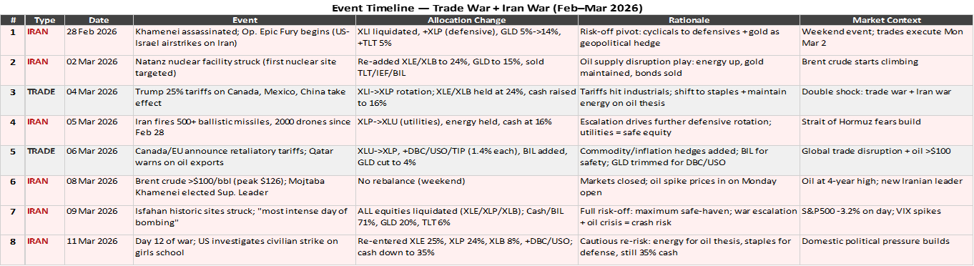
Dynamic Allocation (US Tariffs & Iran Crisis)

Slide 18
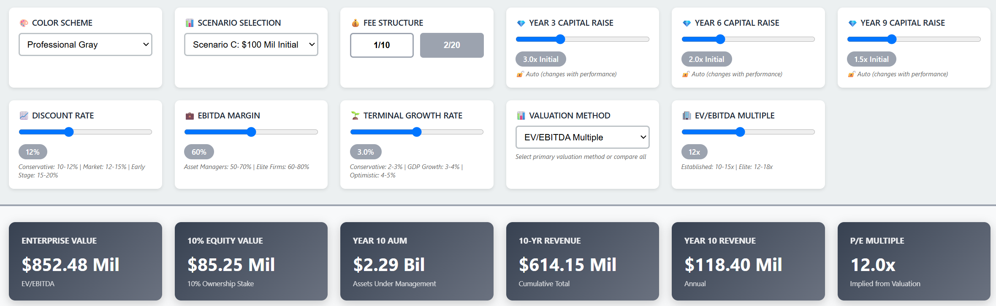
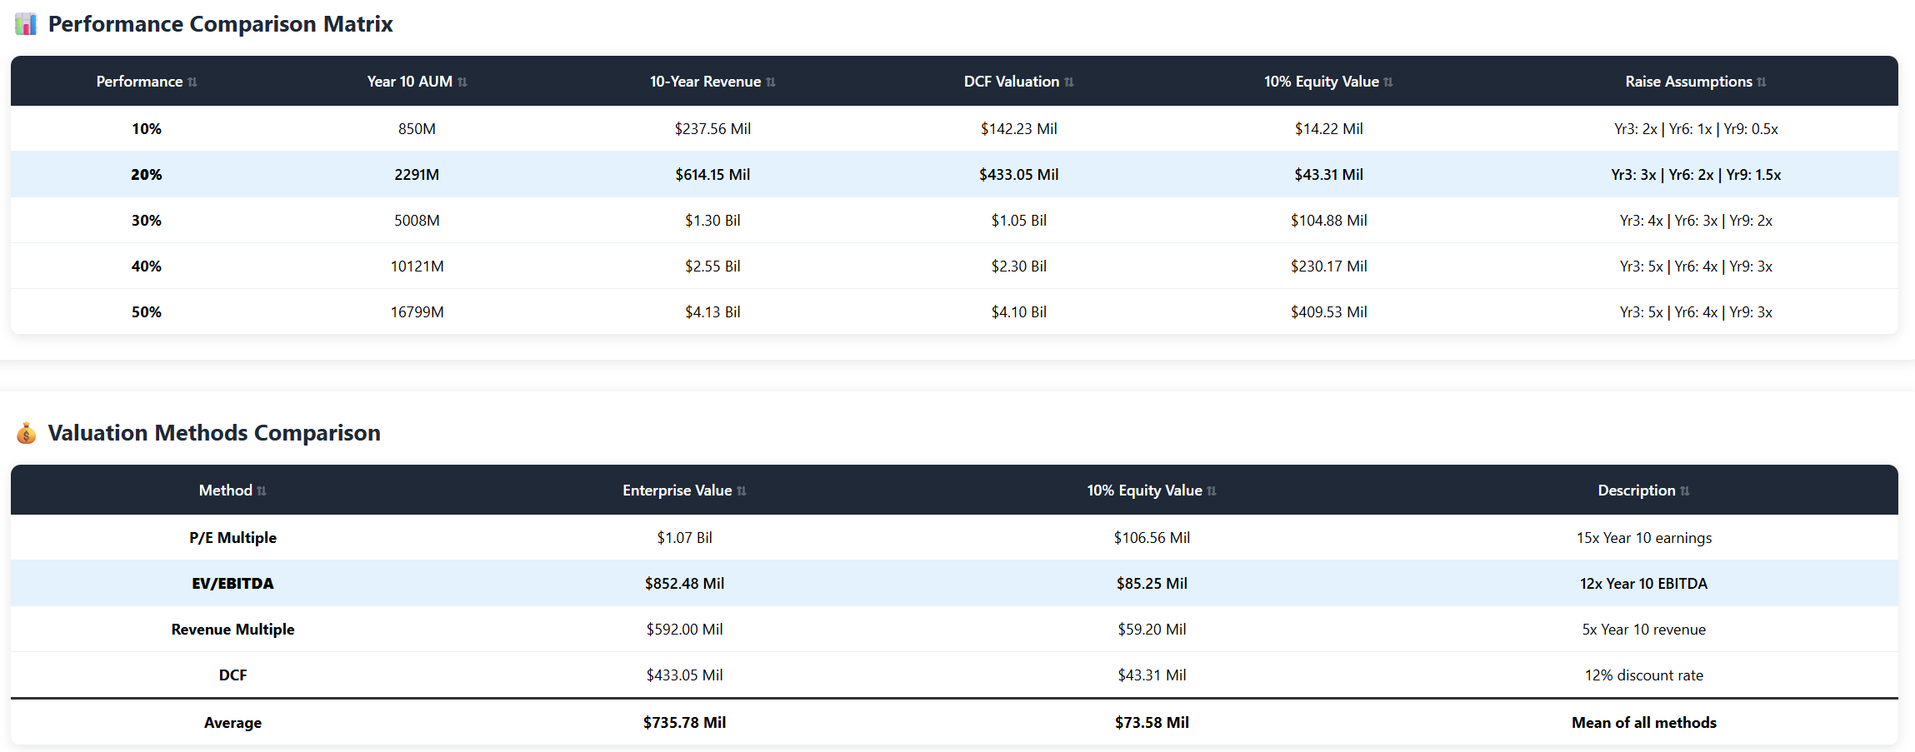
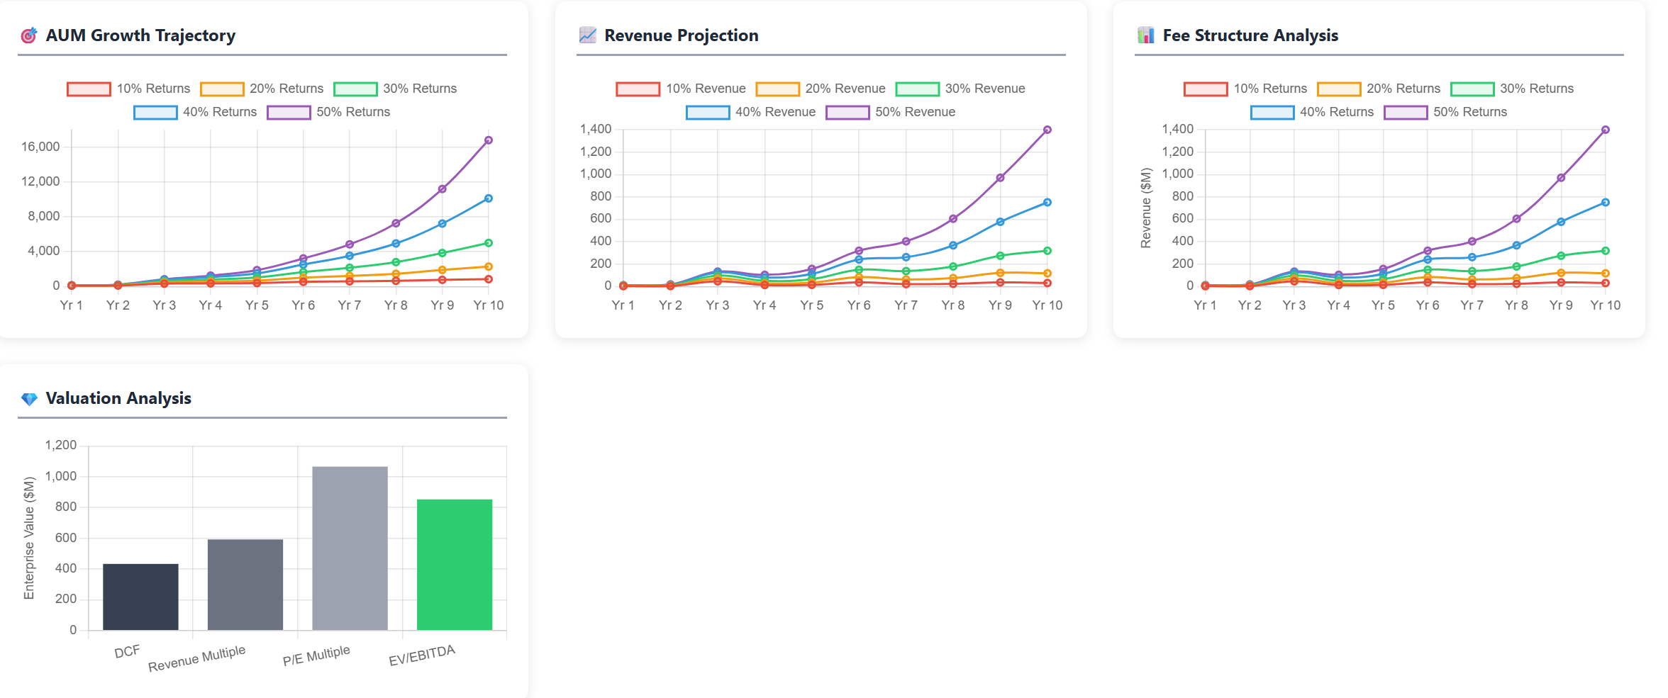
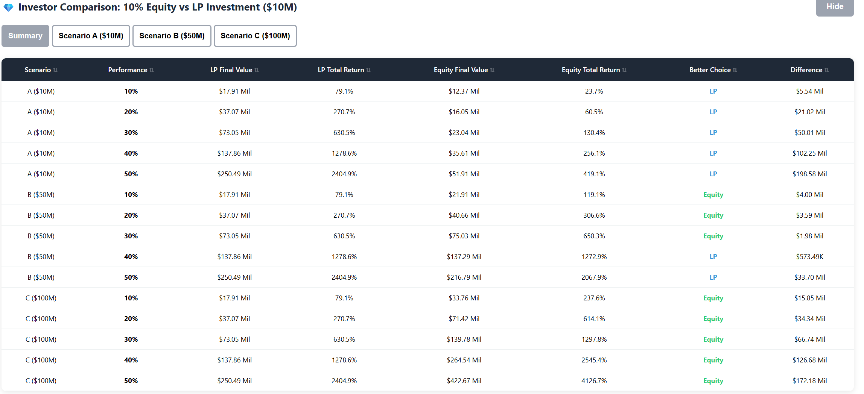
Valuation
A
C
Base Strategies
Base Levered Strategies
B
D

